Slide 1
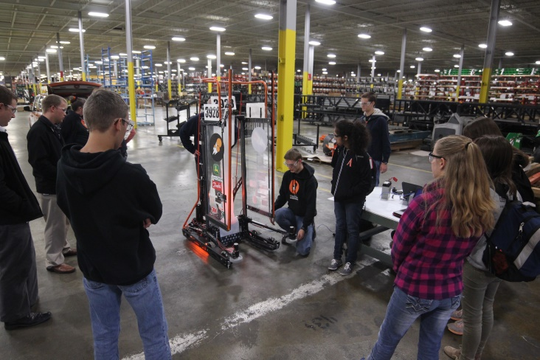
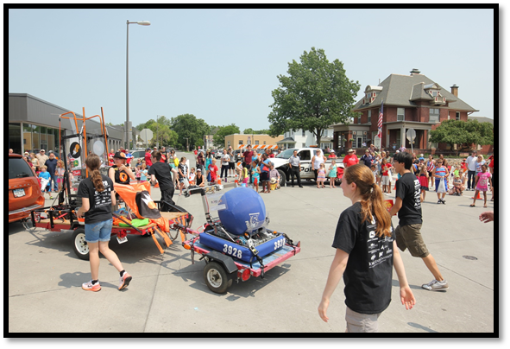
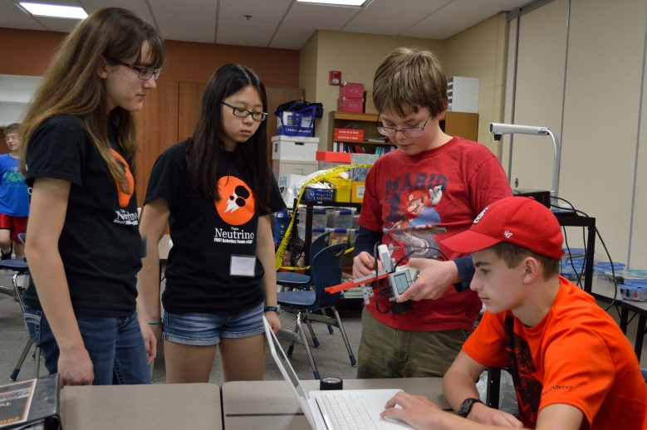
Community Impact
While it is important to share the values and inspiration of FIRST through building a robot, we volunteer our time in many community events to forge new paths and partnerships. One primary goal was to get young students inspired and to become involved in FIRST, the field of engineering, and to be leaders in science and technology.
3928 regularly visits our 17 sponsors to update them on our progress, as well as demo our robot. We do our best to keep in sufficient contact as well as making sure to recognize them for their generous support.
To broaden our impact, we work with other teams to demonstrate our robot and spread the message of FIRST at events hosted by the Science Center of Iowa, including the Girls in Science Festival and the Mini Maker Faire. In addition, we showcase our team at events such as the 4-H Gala, the Iowa State Fair, Ames 4th of July parade, and 23 other events.
To further spread the values and opportunities of FIRST, Team Neutrino has mentored each of the Ames FLL teams since the year of the World Class Challenge. In 2015, Team Neutrino started an FLL Jr. program called Club Quark, this year expanding the program to include 11 teams, all mentored by individual Neutrinos.

Slide 2
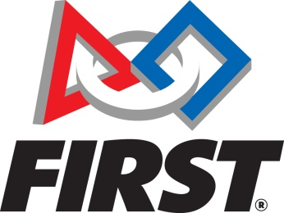
What is FIRST?
FIRST® stands for For Inspiration and Recognition of Science and Technology.
The mission of FIRST is to inspire young people to become future leaders in science and technology by engaging them in exciting mentor-based programs that build proficiency in science, engineering and technology, inspire innovation, and foster soft skills such as self-confidence, communication, ingenuity, and leadership.
The program follows kids from kindergarten all the way through high school, starting with FIRST Lego League Jr. for grades K-3, then FIRST Lego League (FLL) for grades 4-8. FIRST Tech Challenge (FTC) and the FIRST Robotics Challenge (FRC) are for high school students wanting to gain firsthand experience in the engineering world.
Founded by Dean Kamen in 1989, FIRST develops accessible, innovative programs to motivate young people to pursue education and career opportunities in science, technology, engineering, and math, while building self-confidence, knowledge, and life skills.
For more information about FIRST, visit www.firstinspires.org

Slide 3
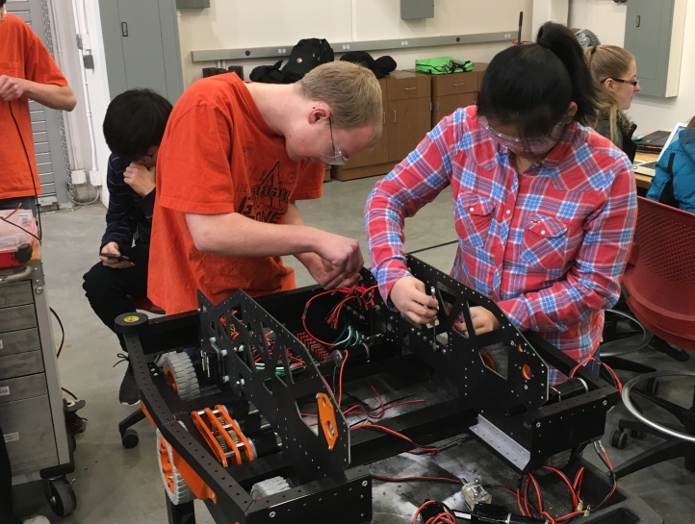
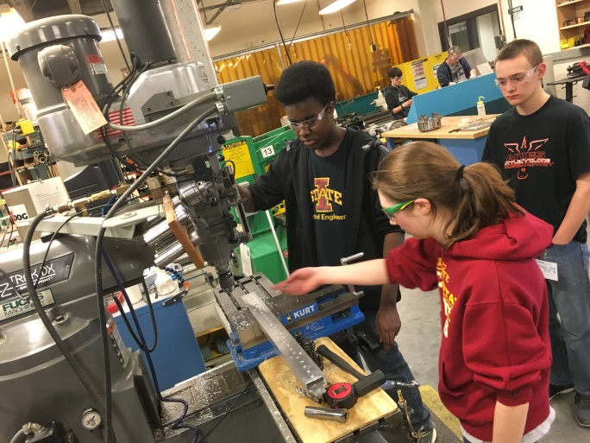
What we Do
Each year FRC teams participate in a competition, the objectives of which are new each year. The new game is released in January of each year through a kickoff event which is televised by NASA and FIRST and broadcast all over the world! After kickoff, each team has 6 weeks to design, build, program and test a robot that fits in the given constraints of the game. After the six weeks have elapsed, the robot must be sealed for competition.
Regional competitions are held in major cities such as Minneapolis, Chicago, and Kansas City. These typically consist of 50-70 teams from anywhere in the world. Competitions occur over a period of 3 days including practice matches, qualification matches, elimination rounds and finals. It’s not all about winning the game, however. Teams are judged for areas including team spirit, community outreach, marketing, robot design, pit safety and appearance and above all “GRACIOUS PROFESSIONALISM.”
Over our five seasons, Team Neutrino has been awarded Highest Seated Rookie, Innovation in Control, Engineering Inspiration, and one of our team members was a Dean’s List finalist.

Slide 4
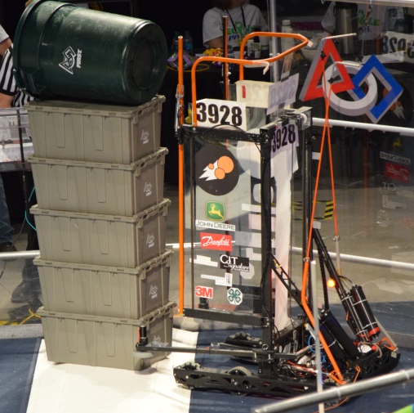
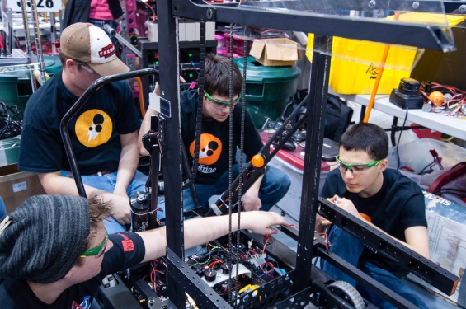
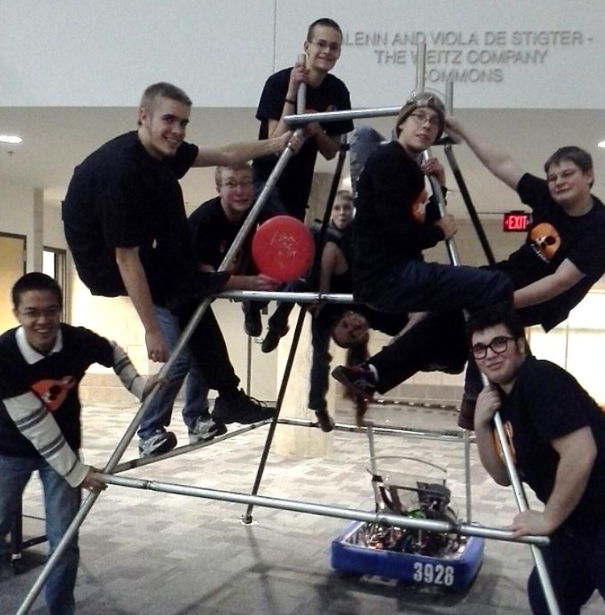
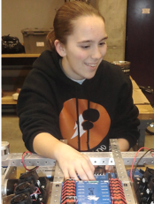
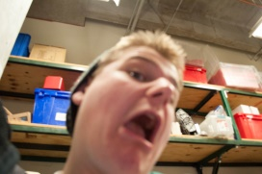
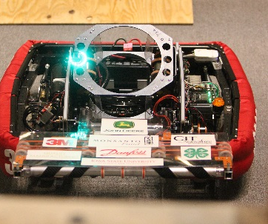
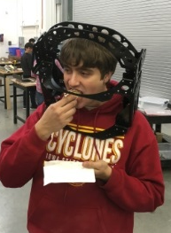
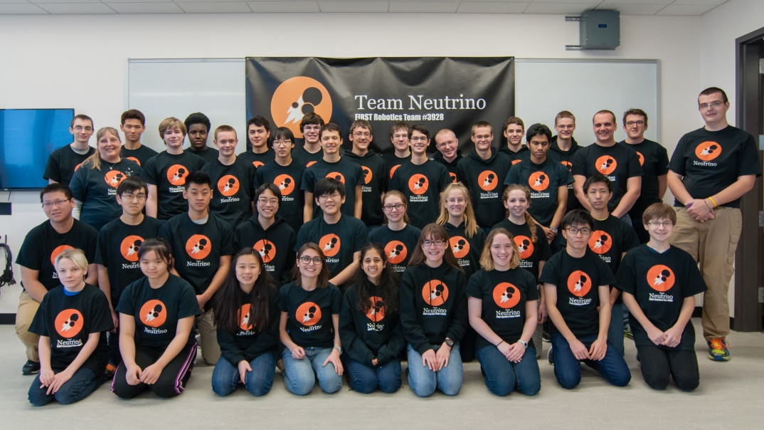
Team Neutrino #3928
Team Neutrino faces the exciting challenge of building a robot to compete in FIRST Robotics Competition (FRC) events. The team was founded in 2012 and is currently a Story County 4-H specialty club composed of high school students from across the Story County area. Students work along-side college and professional mentors to solve problems and learn about the field of engineering. Students are responsible for building the robot, marketing the team, creating a positive team image, designing a website, and fundraising. Members of Team Neutrino also volunteer their time to community events such as mentoring children through summer camps, providing robot demonstrations and doing community service projects.

