Slide 1
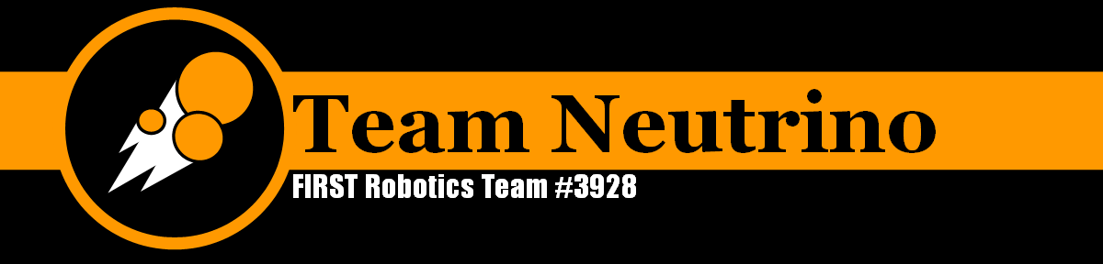

Slide 2
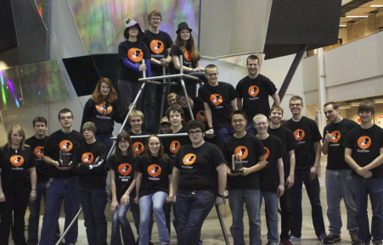
Who we are
FIRST FRC 4-H team #3928 Team Neutrino
Founded 2012
Story County high school students, ISU mentors, Parent mentors
Notes:
Team Neutrino faces the exciting challenge of building a robot to compete in FIRST Robotics Competition events. The team was founded in 2012 and is composed of high school students from the Ames, Ballard, and Nevada area. Students work along-side mentors to solve problems and learn about the field of engineering.

Slide 3
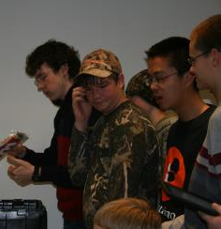
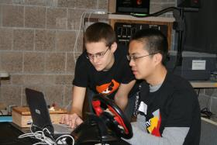
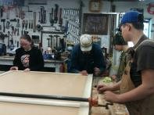
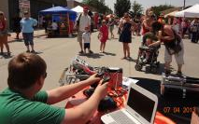
What we do
Build a robot
Market the team
Design a website
Fundraise
Volunteer
Spread the FIRST message
Notes:
Students are responsible for building the robot, marketing the team, creating a positive team image, designing a website, and fundraising. Team Neutrino students also volunteer their time to community events such as mentoring children through summer camps, providing robot demonstrations and doing community service projects.

Slide 4
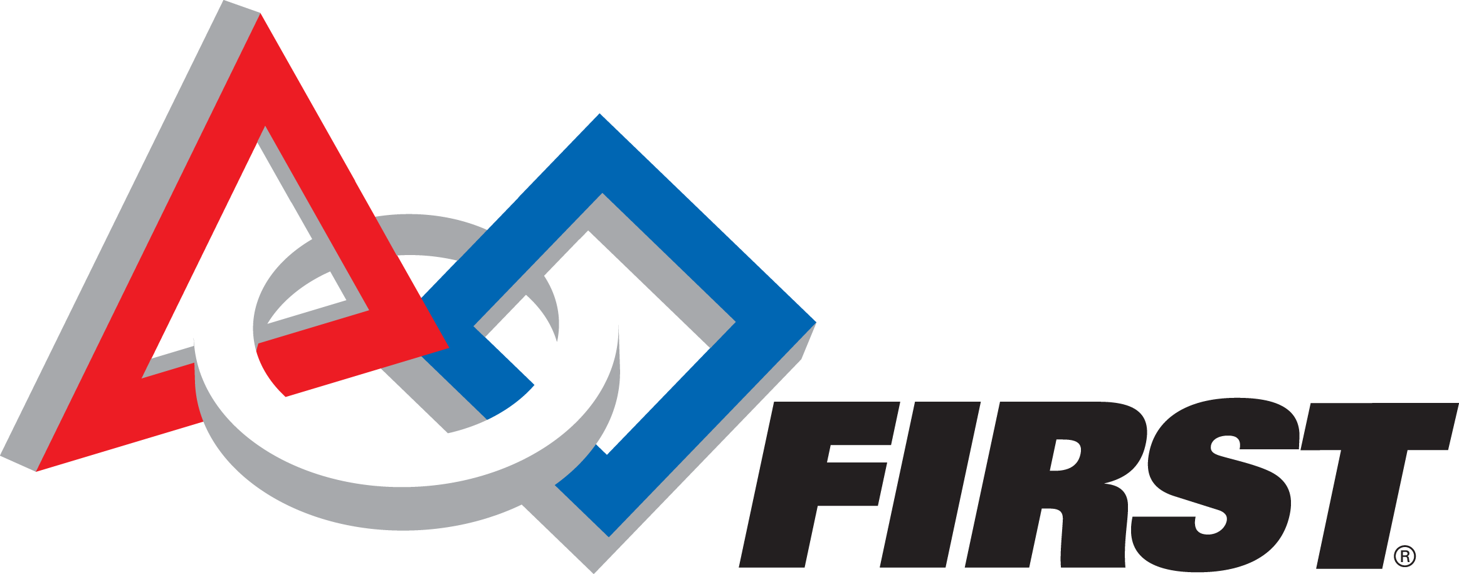
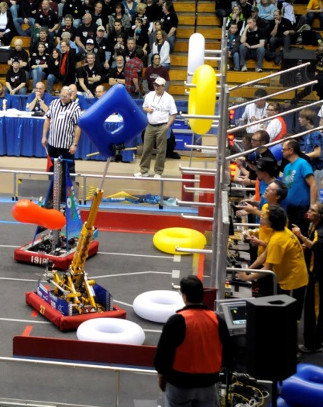
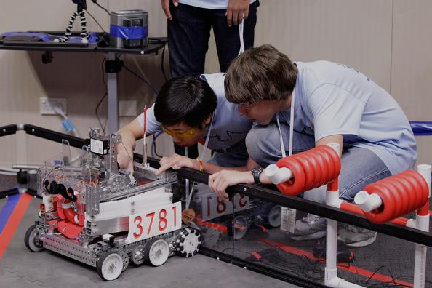
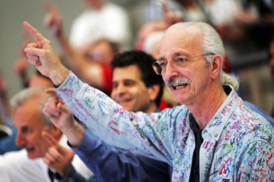
What is ?
FIRST® stands for For Inspiration and Recognition of Science and Technology.
Dean Kamen, 1989
Engineering program (STEM)
Students seven times as likely to major in engineering in college
Life skills
“It’s the hardest fun you’ll ever have!”
Notes:
The mission of FIRST is to inspire young people to be science and technology leaders, by engaging them in exciting mentor-based programs that build science, engineering and technology skills, that inspire innovation, and that foster well-rounded life capabilities including self-confidence, communication, and leadership.
Founded by Dean Kamen in 1989, FIRST develops accessible, innovative programs to motivate young people to pursue education and career opportunities in science, technology, engineering, and math, while building self-confidence, knowledge, and life skills.

Slide 5
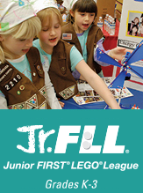

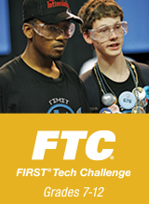
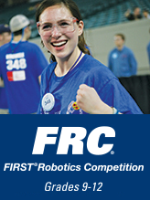

Four levels of FIRST®
Notes:
4 Levels of FIRST
Jr. FLL
Talk to experts
Legos to complete a real-world problem
Create a poster and present to judges
FLL
Robot
Project
Core Values (Gracious Professionalism)
FTC
Build a robot
“Erector set”
Create a team image
FRC
(us)
Larger scale (see pics)
“The Varsity sport for the mind”
It’s as close to “real-world” engineering as a student can get.
There are four “levels” of the FIRST program: Jr. FLL, FIRST Lego League, FIRST Tech Challenge, and FIRST Robotics Challenge (that’s us). Jr. FLL is for grades K-3, and kids use legos to build a solution to that year’s topic after talking to experts in the field. The next step is FLL, which is for grades 4-8. There are three components to FLL. The first is for them to build a robot out of legos to complete “missions” on a mat. The next is to research that year’s real-world challenge (usually the same as Jr. FLL), and design an innovative solution. The last component is Gracious Professionalism, which is prevalent throughout all of FIRST. FIRST Tech Challenge is for grades 9-12. Teams are responsible for designing, building, and programming their robots to compete in an alliance format against other teams. Robots are built using a kit similar to an Erector set. FRC, (which is what our team is), is also for grades 9-12, but the robot is on a much larger scale, as you can see in the pictures. "The varsity Sport for the Mind," FRC combines the excitement of sport with the rigors of science and technology. Under strict rules, limited resources, and time limits, teams of 25 students or more are challenged to raise funds, design a team "brand," hone teamwork skills, and build and program robots to perform prescribed tasks against a field of competitors. It’s as close to "real-world engineering" as a student can get.

Slide 6
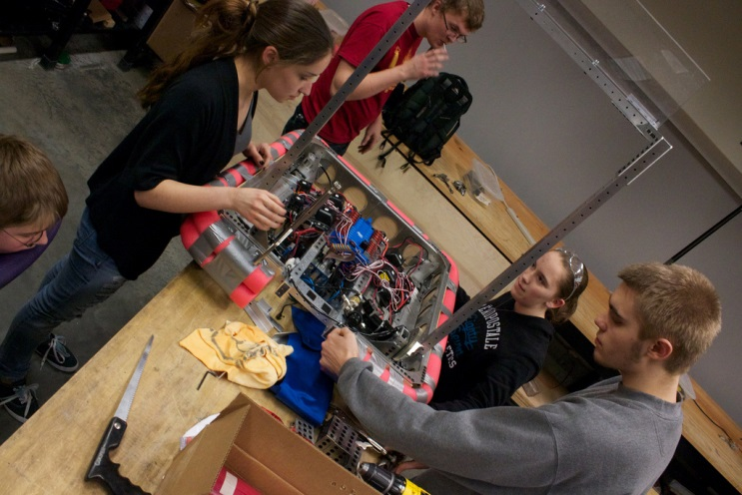
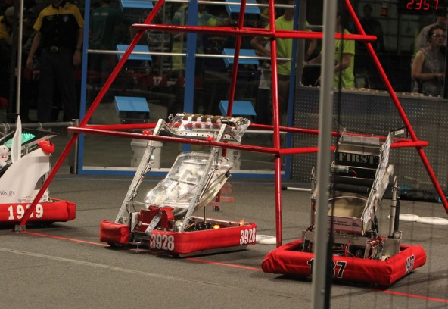
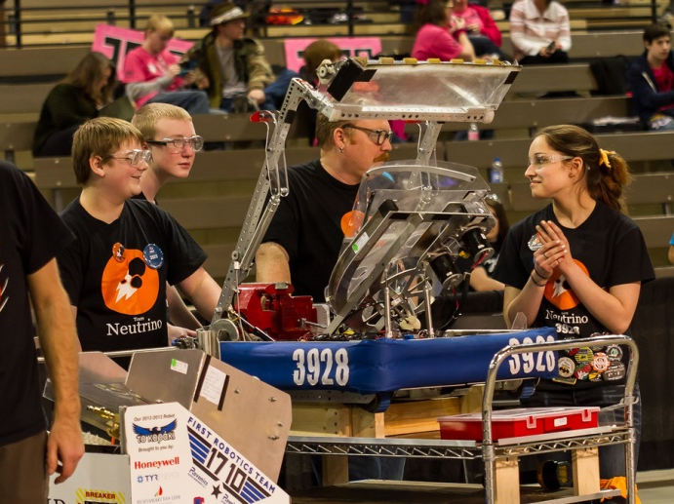
The FRC season
New game each year
6 week build season
3-day competitions
“Gracious Professionalism”
Notes:
Each year FRC teams participate in a competition, the objectives of which are new each year. The new game is released in January of each year at kickoff which is televised by NASA and FIRST all over the world! After kickoff, each team has 6 weeks to design, build, and program a robot that fits in the given constraints of the game. After the six weeks have elapsed, the robot must be sealed for competition.
Regional competitions are held in major cities such as Minneapolis, Chicago, and Kansas City. These typically consist of 50-70 teams from anywhere in the world. Competitions occur over a period of 3 days including practice matches, qualification matches, elimination rounds and finals. It’s not all about winning the game. Teams are judged for areas including team spirit, community outreach, marketing, the robot, design, pit safety and appearance and above all “GRACIOUS PROFESIONALISM.”

Slide 7
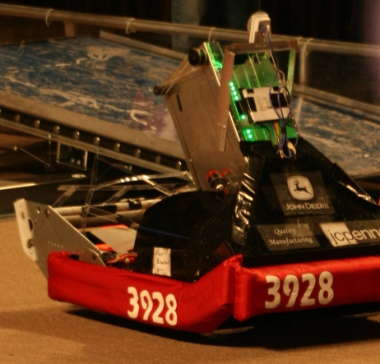
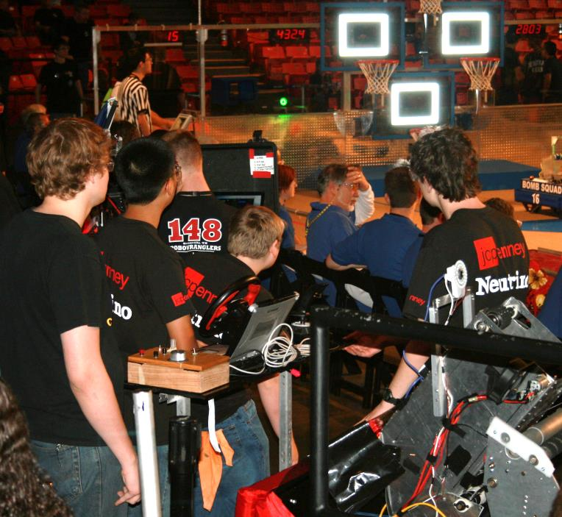
Neutrino’s Achievements: 2012
Midwest Regional (Chicago)
Ranked 8th
Highest rookie seed award
Captain of the 5th alliance

Slide 8
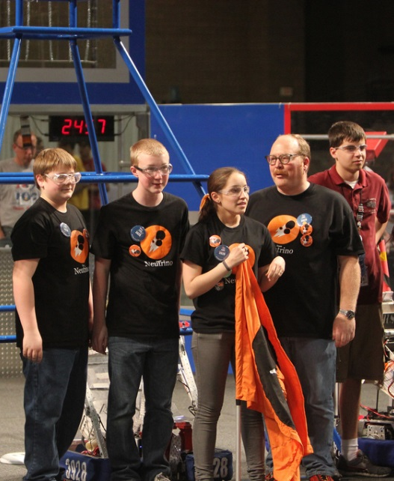
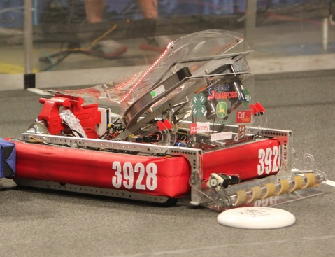
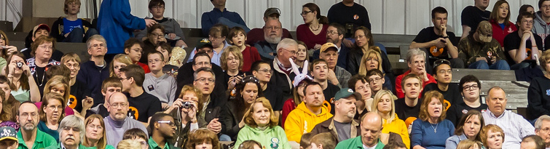
Neutrino’s Achievements: 2013
Greater Kansas City Regional
Ranked 9th
Selected by the 2nd alliance
Finalist
Excellence in Engineering Award

Slide 9
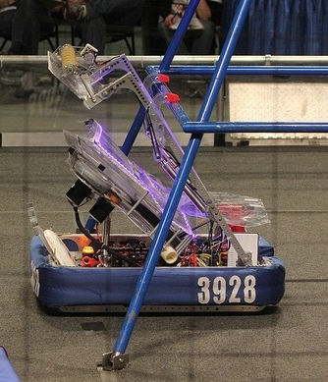
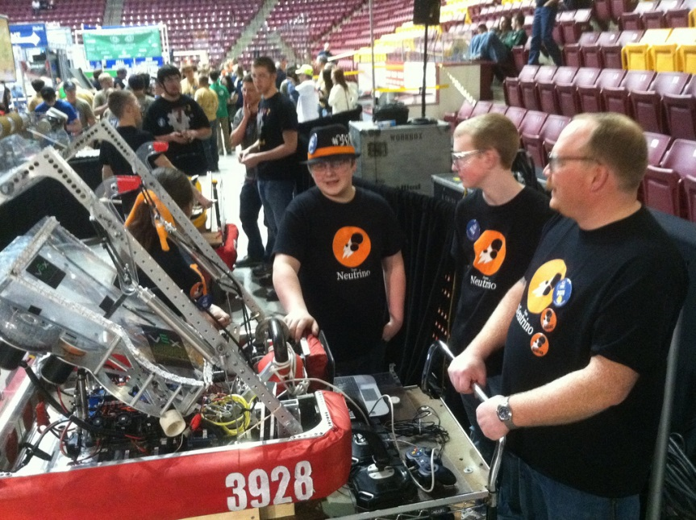
Neutrino’s Achievements: 2013
Minnesota North Star Regional
Ranked 1st
Finalist
Innovation in Control Award

Slide 10
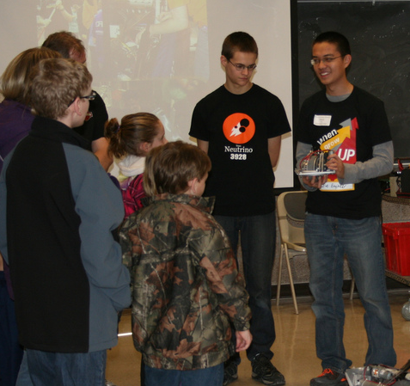
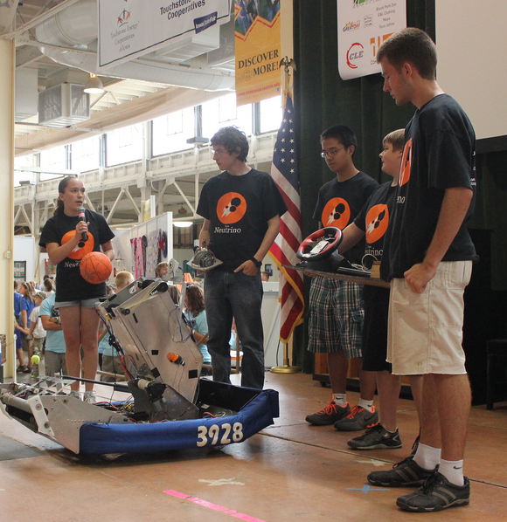
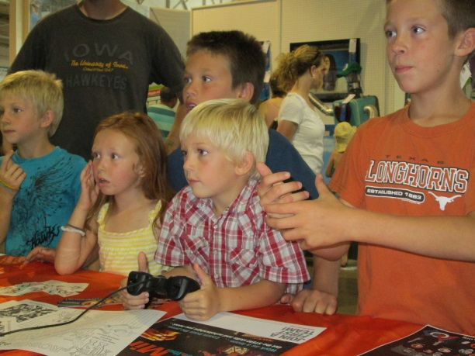
Community Outreach
Get kids excited about STEM
Summer classes, TAG program
Volunteered for FLL
County Fair, State Fair
SCI’s “FIRST Day”
Iowa’s “STEM Day”
Notes:
While it is important to share the values and inspiration of FIRST through building a robot, we volunteer our time in many community events to forge new paths and partnerships. One primary goal was to get young students inspired and to become involved in FIRST, the field of engineering, and to be leaders in science and technology.
Team Neutrino taught summer classes in the Ames Community School District’s Super Summer camp, a Talented and Gifted program designed to get elementary and middle school students excited about a wide range of topics. To continue the support of FLL during their Senior Solutions season, Team Neutrino volunteered at Iowa FLL tournaments and mock matches. During the Rebound Rumble offseason, Team Neutrino traveled to Des Moines, Iowa to share our rookie team’s robot at a local high school to inspire them to start the sixth FRC team in Iowa. Outside of FIRST, our team has been active in becoming a 4-H club. We participate in the Iowa State Fair and at our county fair each year. Along with these activities we participate in the Science Center of Iowa’s “First Day” and Iowa’s STEM Day where we talk to state legislators about FRC and FIRST as a whole.

Slide 11
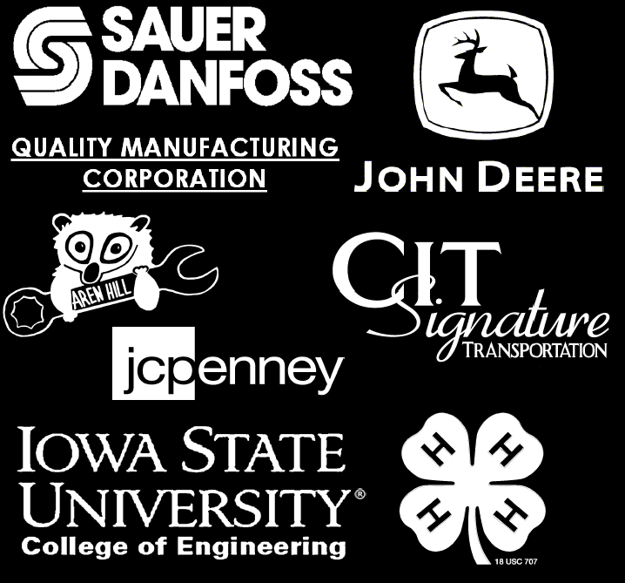
2013 Sponsors

Slide 12
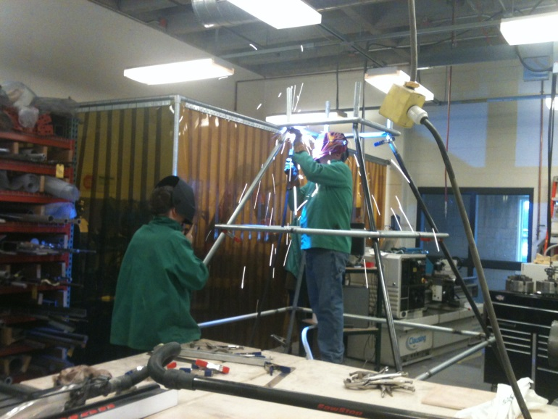
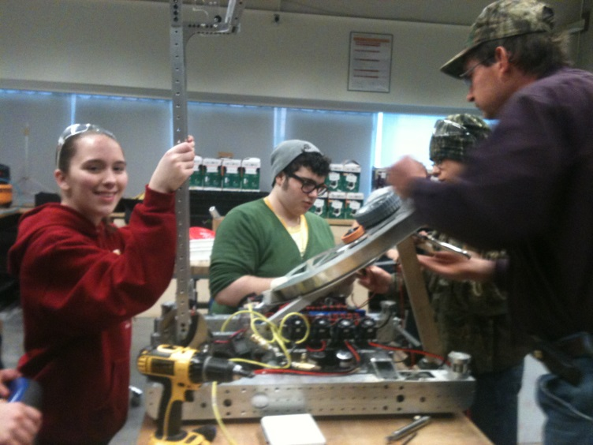
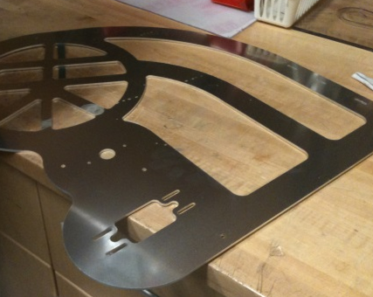
Sponsors are essential
Monetary donations
Robot parts
Travel expenses
In-kind donations
Fabrication of parts

Slide 13
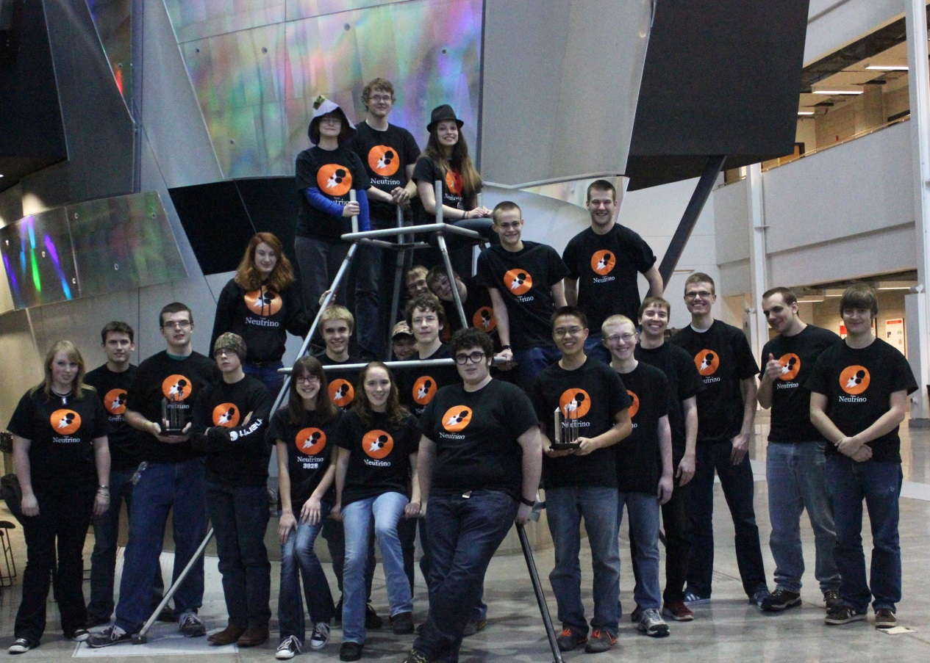
Thank you for
your support!

