Slide 1
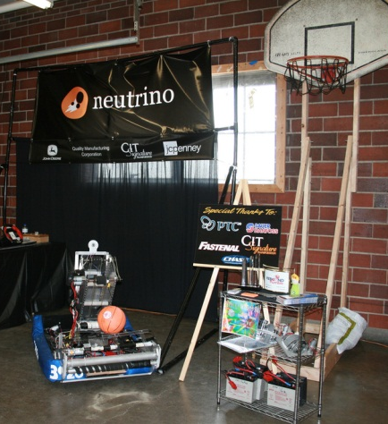
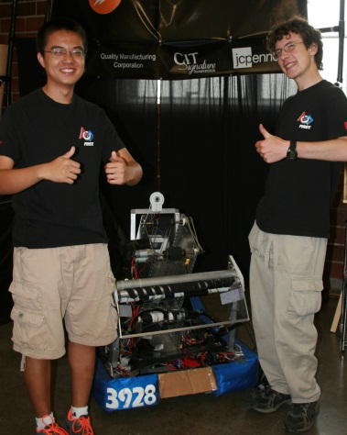
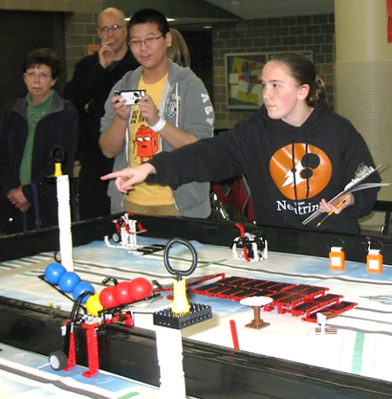
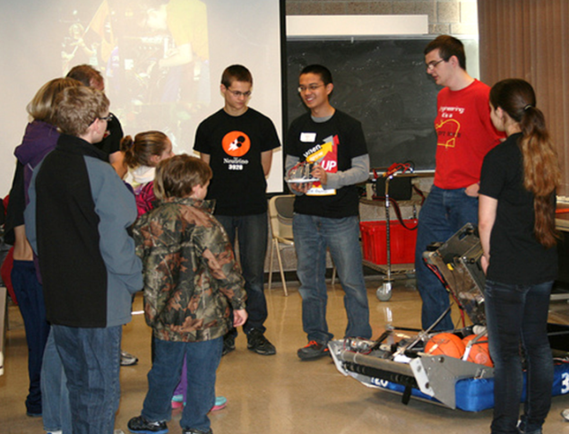
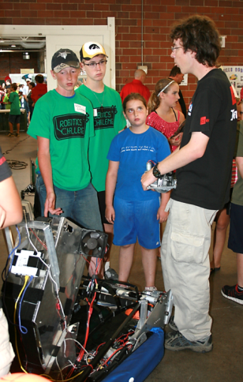
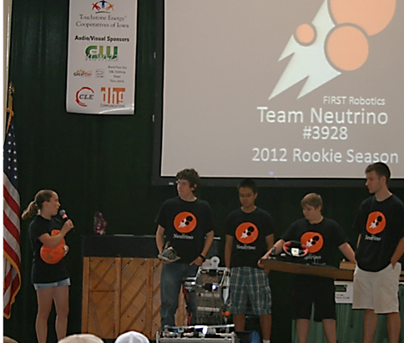
Community Impact
While it is important to share the values and inspiration of FIRST through building a robot, we volunteer our time in many community events to forge new paths and partnerships. One primary goal was to get young students inspired and to become involved in FIRST, the field of engineering, and to be leaders in science and technology.
Team Neutrino taught summer classes in the Ames Community School District’s Super Summer camp, a Talented and Gifted program designed to get elementary and middle school students excited about a wide range of topics. To continue the support of FLL during their Senior Solutions season, Team Neutrino volunteered at Iowa FLL tournaments and mock matches. During the Rebound Rumble offseason, Team Neutrino traveled to Des Moines, Iowa to share our rookie team’s robot at a local high school to inspire them to start the sixth FRC team in Iowa. Outside of FIRST, our team has been active in becoming a 4-H club. We participate in the Iowa State Fair and at our county fair each year. Along with these activities we participate in the Science Center of Iowa’s “First Day” and Iowa’s STEM Day where we talk to state legislators about FRC and FIRST as a whole.
Our sponsors, mentors and the community believe in and inspire us to achieve our full potential and to encourage others to do the same.

Slide 2
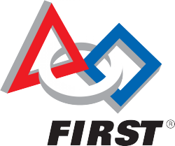
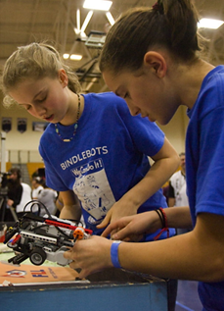
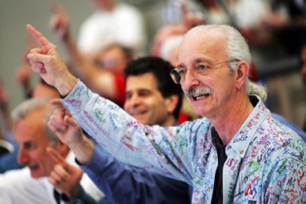
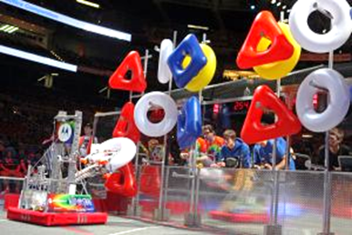
What is FIRST?
FIRST® stands for For Inspiration and Recognition of Science and Technology.
The mission of FIRST is to inspire young people to be science and technology leaders, by en- gaging them in exciting mentor-based pro- grams that build science, engineering and technology skills, that inspire innovation, and that foster well-rounded life capabilities include- ing self-confidence, communication, and lead- ership.
The program follows kids from kindergarten all the way through high school, starting with Jr. FIRST Lego League (FLL) for grades K-3, then FLL for grades 4-8. FIRST Tech Challenge (FTC) and the FIRST Robotics Challenge (FRC) are for high school students wanting to gain firsthand experience in the engineering world.
Founded by Dean Kamen in 1989, FIRST develops accessible, innovative programs to motivate young people to pursue education and career opportunities in science, technology, engineering, and math, while building self-confidence, knowledge, and life skills.
For more information about FIRST, visit www.usfirst.org.

Slide 3
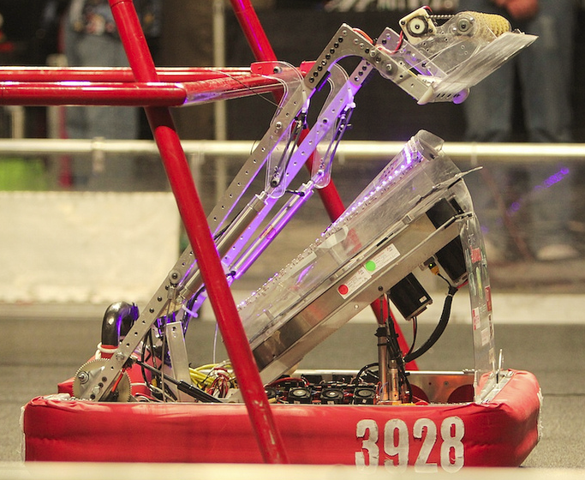
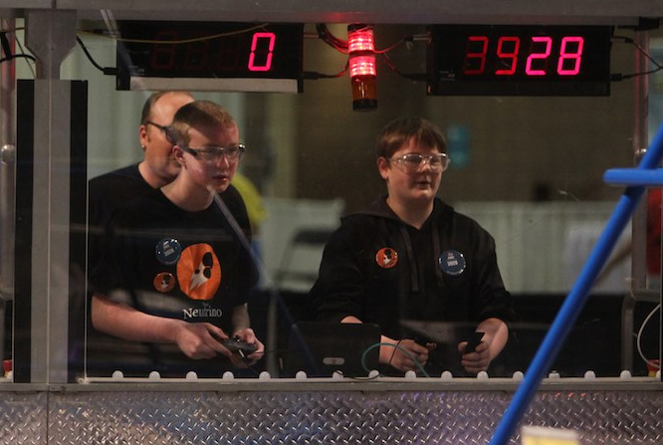
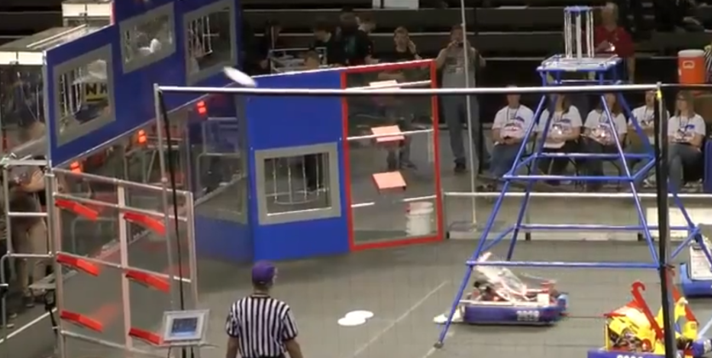
What we Do
Each year FRC teams participate in a competition, the objectives of which are new each year. The new game is released in January of each year through a kickoff event which is televised by NASA and FIRST and broadcast all over the world! After kickoff, each team has 6 weeks to design, build, program and test a robot that fits in the given constraints of the game. After the six weeks have elapsed, the robot must be sealed for competition.
Regional competitions are held in major cities such as Minneapolis, Chicago, and Kansas City. These typically consist of 50-70 teams from anywhere in the world. Competitions occur over a period of 3 days including practice matches, qualification matches, elimination rounds and finals. It’s not all about winning the game, however. Teams are judged for areas including team spirit, community outreach, marketing, robot design, pit safety and appearance and above all “GRACIOUS PROFESIONALISM.”
In our 2014 season, Aerial Assist, Team Neutrino won the Engineering Inspiration award, which then allowed the team to advance to the global championship held in St. Louis, Missouri. This was a great reward for all the hard work the team put into the season.

Slide 4
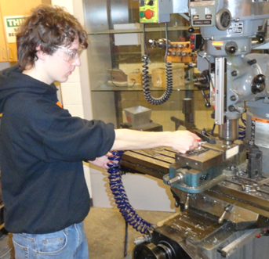
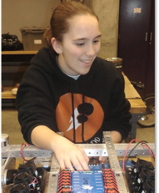
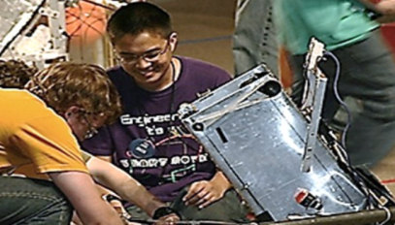
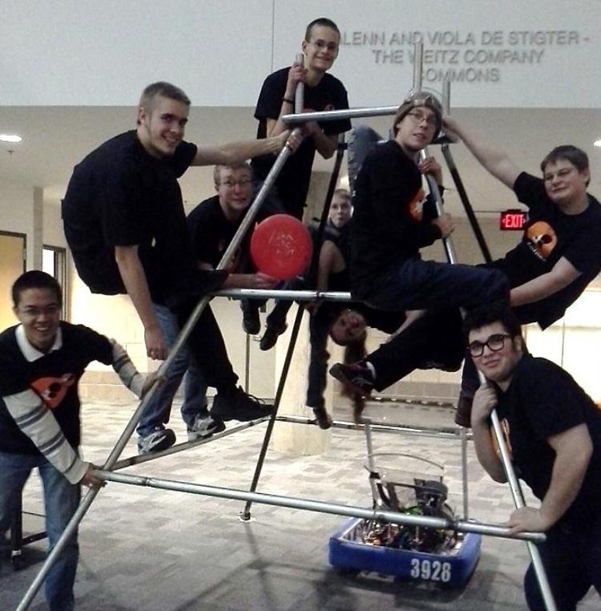
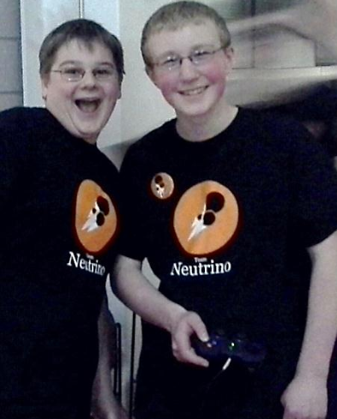
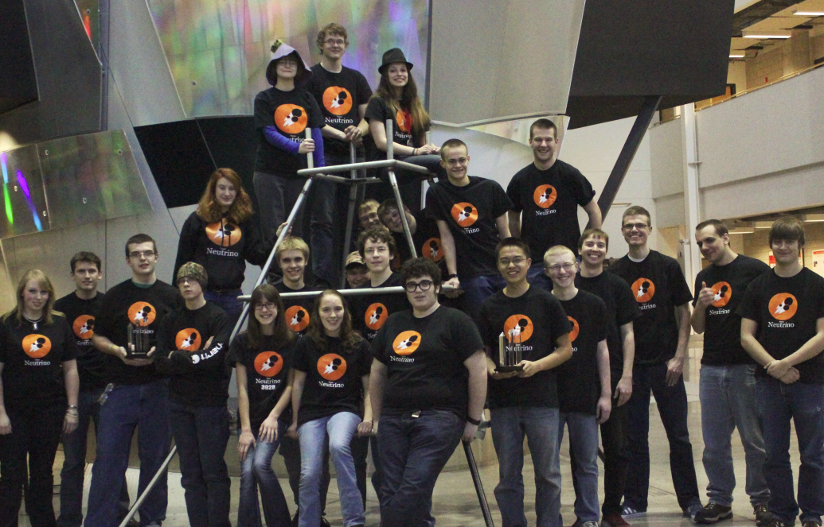

Team Neutrino #3928
Team Neutrino faces the exciting challenge of building a robot to compete in FIRST Robotics Competition events (FRC). The team was founded in 2012 and is currently a Story County 4-H specialty club composed of high school students from the Ames, Ballard, and Nevada area. Students work along-side college and professional mentors to solve problems and learn about the field of engineering. Students are responsible for building the robot, marketing the team, creating a positive team image, designing a website, and fundraising. Members of Team Neutrino also volunteer their time to community events such as mentoring children through summer camps, providing robot demonstrations and doing community service projects.

