Slide 1

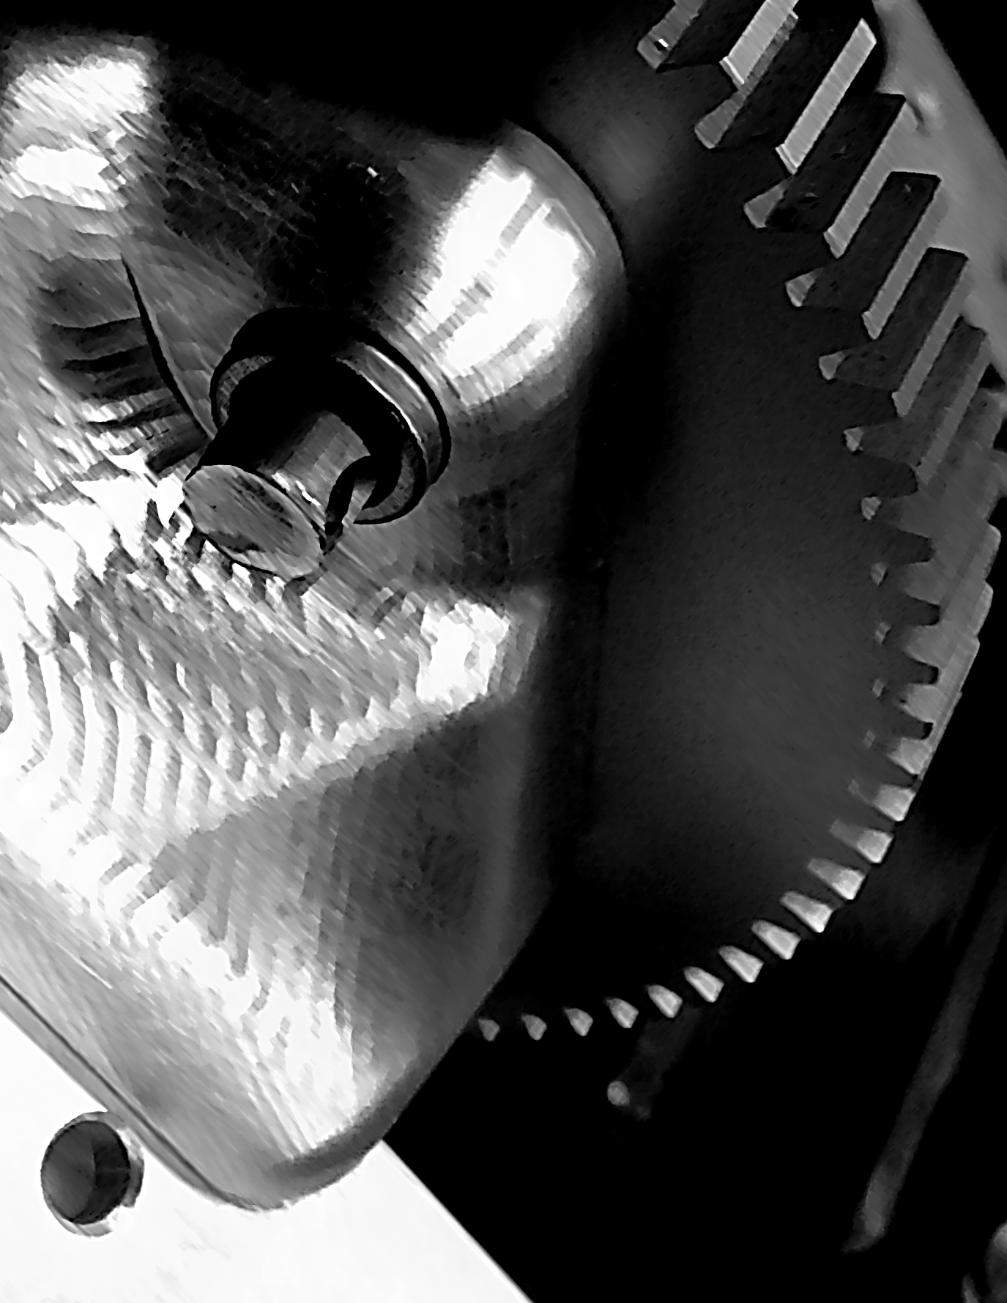
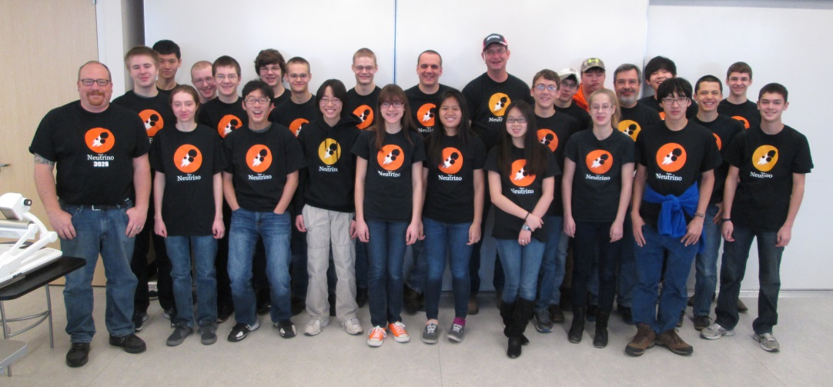
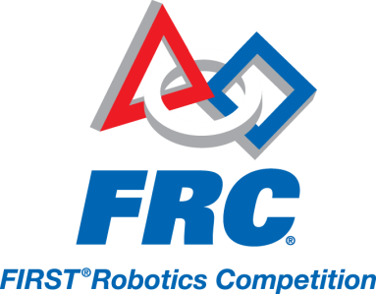
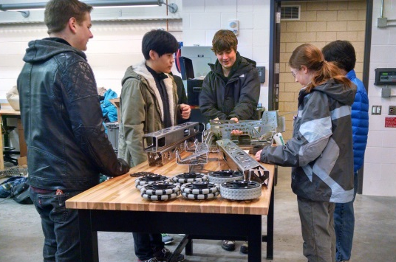
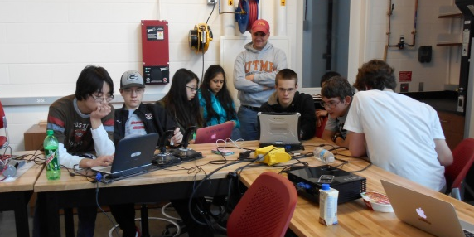

During the past 6 weeks the team has been hard at work designing, building, and programming a robot to compete in this year’s game, Recycle Rush.
You are invited to Team Neutrino’s 2015 Robot Reveal!
Where: Howe Hall atrium,
ISU campus
When: 6:30-8pm,
Sunday, February 15th
Comp’s: Central Illinois (March 18-21)
MN North Star (April 1-4)
Special Thanks to our Sponsors: John Deere, Danfoss, CIT Signature Transportation, Monsanto Fund, Quality Manufacturing Corporation, 3M, Iowa 4-H Foundation, Iowa State University College of Engineering, Iowa State University College of Engineering Robotics Club, Boyd Lab, Shaw Philidelphia Commercial, Emerson Process Management, Interstate All-Battery Center, Frontline Bioenergy, Jimmy John’s
www.teamneutrino.org

