Slide 1
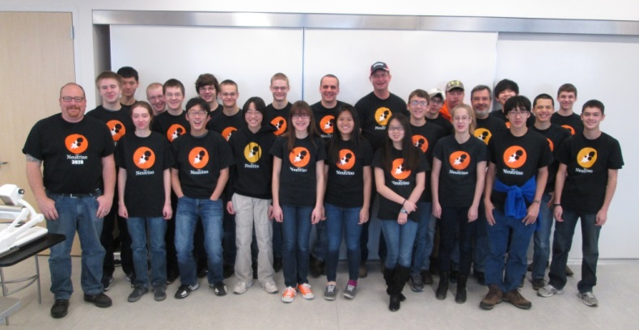
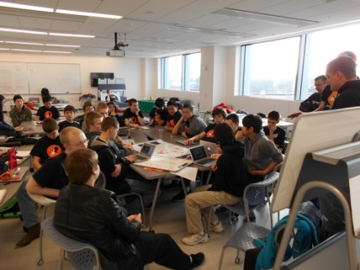
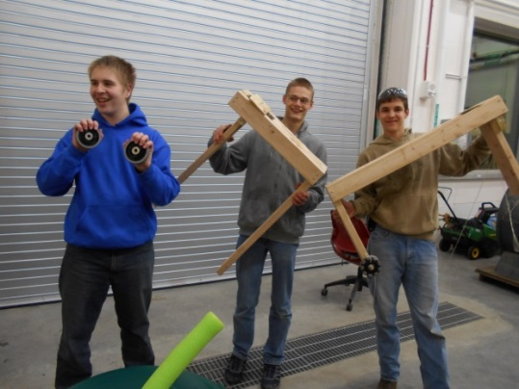
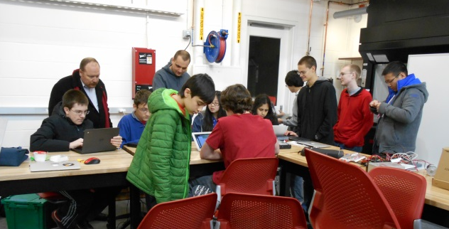

Team Neutrino
Newsletter Week #1
Kickoff
Our 2015 build season started last Saturday with the global broadcast of this year’s game,
Recycle Rush. After watching the game reveal, we broke into small groups to read the rules and develop strategies. We then brainstormed robot design ideas as a large group. Special thanks to Jimmy John’s for catering lunch!
Prototyping
This year’s game will require robots to be able to do a variety of things such as pick up and stack totes and place recycling bins on top of stacks. The mechanical sub-team built prototypes for our robot’s intake mechanism.
Programming
The programming sub-team was busy this week with getting last year’s robot ready for our outreach booth at the Iowa State FLL championship. They also finished the electrical board for this year’s robot.
CADD
We decided to build a tank drive for our robot this year. This week, the CADD sub-team got started on designing the drive drain.
2015
Coming Next Week: Come check us out at the Iowa State FLL championship on January 17th!

